Slide 1
Scan Conversion in Computer Graphics

Slide 2
INTRODUCTION
“Scan Conversion is te represention of regular objects in the form of discrete pixels,” Every graphics system must transform the primitives into a collection of pixels. The scan conversion is also called “Rasterization.” Each pixel in the graphical system has two states either on or off.
“The Scan Converting rate is a technique that is used in video processing. In this technique, we can change the horizontal and vertical frequency for many different purposes.” We use a scan converter to perform scan conversions. We can define a line by its starting and ending points. On the other hand, we can define a circle by its radius, circle equation, and center point.

Slide 3
Methods of Scan Conversion
We can perform scan conversion by using two methods.
Analog Method
Digital Method
Analog Method: It is the best method for analog videos. The Analog approach is also known as “Non-retentive, memory-less, or real-time method.”
Digital Method: Digital method is also known as a “retentive or buffered method.” In the digital method, there is a concept of n₁and n₂ speed. We can save (Store) the picture in line or frame buffer with n₁ speed. The image can be read with n₂ speed.

Slide 4
Advantages of Scan Conversion
The scan conversion technique is used for various display units, such as videoProjectors, TV, HDTV, Video capture card, LCD monitor, etc.
The Scan Conversion technique has wide applications.
We can efficiently perform scan conversion using high speed integrated circuits.

Slide 5
Disadvantages of Scan Conversion
We can only apply scan conversion with LSI and VLSI integrated circuit.
In the digital scan conversion, the analog video signal has changed into digital data.

Slide 6
Line Drawing Algorithm in Computer Graphics

Slide 7
Properties of a Line Drawing Algorithm
There are the following properties of a good Line Drawing Algorithm.
An algorithm should be precise: Each step of the algorithm must be adequately defined.
Finiteness: An algorithm must contain finiteness. It means the algorithm stops after the execution of all steps.
Easy to understand: An algorithm must help learners to understand the solution in a more natural way.
Correctness: An algorithm must be in the correct manner.
Effectiveness: The steps of an algorithm must be valid and efficient.
Uniqueness: All steps of an algorithm should be clearly and uniquely defined, and the result should be based on the given input.
Input: A good algorithm must accept at least one or more input.
Output: An algorithm must generate at least one output.

Slide 8
Equation of the straight line
We can define a straight line with the help of the following equation.
y= mx + a
  Where,
  (x, y) = axis of the line.
  m = Slope of the line.
    a = Interception point

Slide 9
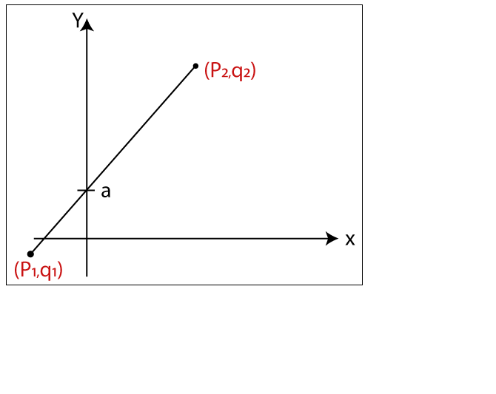

Slide 10
Algorithms of Line Drawing
There are following algorithms used for drawing a line:
DDA (Digital Differential Analyzer) Line Drawing Algorithm
Bresenham’s Line Drawing Algorithm
Mid-Point Line Drawing Algorithm

Slide 11
DDA (Digital Differential Analyzer) Line Drawing Algorithm
The Digital Differential Analyzer helps us to interpolate the variables on an interval from one point to another point. We can use the digital Differential Analyzer algorithm to perform rasterization on polygons, lines, and triangles.
Digital Differential Analyzer algorithm is also known as an incremental method of scan conversion. In this algorithm, we can perform the calculation in a step by step manner using the line equation.

Slide 12
As we know the general equation of the straight line is:y = mx + c
Here, m is the slope of (x₁, y₁) and (x₂, y₂). m = (y₂ – y₁)/ (x₂ – x₁)
Now, we consider one point (x_{k}, y_{k}) and (x_{k+1}, y_{k+1}) as the next point.
Then the slope m = (y_{k+1} – y_{k})/ (x_{k+1} – x_{k})
There can be following three cases to discuss:
Case 1: If m < 1
Then x coordinate tends to the Unit interval. x_{k+1} = x_{k} + 1
y_{k+1} = y_{k} + m
Case 2: If m > 1
Then y coordinate tends to the Unit interval. y_{k+1} = y_{k} + 1
x_{k+1} = x_{k} + 1/m
Case 3: If m = 1
Then x and y coordinate tend to the Unit interval.
x_{k+1} = x_{k} + 1
y_{k+1} = y_{k} + 1

Slide 13
Algorithm of Digital Differential Analyzer (DDA) Line Drawing
Step 1: Start.
Step 2: We consider Starting point as (x₁, y₁), and ending point (x₂, y₂).
Step 3: Now, we have to calculate ?x and ?y. ?x = x₂-x₁
?y = y₂-y₁
m = ?y/?x
Step 4: Now, we calculate three cases.
If m < 1
Then x change in Unit Interval, y moves with deviation
(x_{k+1}, y_{k+1}) = (x_{k}+1, y_{k}+m)
If m > 1
Then x moves with deviation, y change in Unit Interval
(x_{k+1}, y_{k+1}) = (x_{k}+1/m, y_{k}+1)
If m = 1
Then x moves in Unit Interval, y moves in Unit Interval
(x_{k+1}, y_{k+1}) = (x_{k}+1, y_{k}+1)
Step 5: We will repeat step 4 until we find the ending point of the line.
Step 6: Stop.

Slide 14
Example: A line has a starting point (1,7) and ending point (11,17). Apply the Digital Differential Analyzer algorithm to plot a line.
Solution: We have two coordinates,
Starting Point = (x₁, y₁) = (1,7)
Ending Point = (x₂, y₂) = (11,17)
Step 1: First, we calculate ?x, ?y and m.
?x = x₂ – x₁ = 11-1 = 10
?y = y₂ – y₁ = 17-7 = 10
m = ?y/?x = 10/10 = 1
Step 2: Now, we calculate the number of steps.
?x = ?y = 10
Then, the number of steps = 10
Step 3: We get m = 1, Third case is satisfied.
Now move to next step.

Slide 15
The coordinates of drawn line are-
P₁ = (2, 8)
P₂ = (3, 9)
P₃ = (4, 10)
P₄ = (5, 11)
P₅ = (6, 12)
P₆ = (7, 13)
P₇ = (8, 14)
P₈ = (9, 15)
P₉ = (10, 16)
P₁₀ = (11, 17)

Slide 16
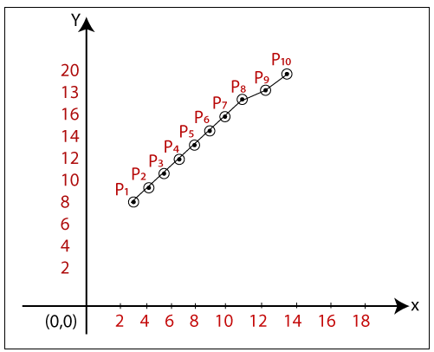

Slide 17
Advantages of Digital Differential Analyzer
It is a simple algorithm to implement.
It is a faster algorithm than the direct line equation.
We cannot use the multiplication method in Digital Differential Analyzer.
Digital Differential Analyzer algorithm tells us about the overflow of the point when the point changes its location.
Disadvantages of Digital Differential Analyzer
The floating-point arithmetic implementation of the Digital Differential Analyzer is time-consuming.
The method of round-off is also time-consuming.
Sometimes the point position is not accurate.

Slide 18
Bresenham’s Line Drawing Algorithm in Computer Graphics
This algorithm was introduced by “Jack Elton Bresenham” in 1962. This algorithm helps us to perform scan conversion of a line. It is a powerful, useful, and accurate method. We use incremental integer calculations to draw a line. The integer calculations include addition, subtraction, and multiplication.

Slide 19
Step 1: Start.
Step 2: Now, we consider Starting point as (x₁, y₁) and endingpoint (x₂, y₂).
Step 3: Now, we have to calculate ?x and ?y.
?x = x₂-x₁
?y = y₂-y₁
m = ?y/?x
Step 4: Now, we will calculate the decision parameter p_{k} with following formula.
p_{k} = 2?y-?x
Step 5: Theinitial coordinates of the line are (x_{k}, y_{k}), and the next coordinatesare (x_{k+1}, y_{k+1}). Now, we are going to calculate two cases for decision parameter p_{k}

Slide 20
Case 1: If
p_{k} < 0
Then
p_{k+1} =p_{k} +2?y
x_{k+1} = x_{k} +1
y_{k+1} = y_{k}
Case 2: If
p_{k} >= 0
Then
p_{k+1} =p_{k} +2?y-2?x
x_{k+1} =x_{k} +1
y_{k+1} =y_{k} +1

Slide 21
Step 6: We will repeat step 5 until we found the ending point of the line and the total number of iterations =?x-1.
Step 7: Stop.

Slide 22
Example: A line has a starting point (9,18) and ending point (14,22). Apply the Bresenham’s Line Drawing algorithm to plot a line.
Solution: We have two coordinates,
Starting Point = (x₁, y₁) = (9,18)
Ending Point = (x₂, y₂) = (14,22)
Step 1: First, we calculate ?x, ?y.
?x = x₂ – x₁ = 14-9 = 5
?y = y₂ – y₁ = 22-18 = 4
Step 2: Now, we are going to calculate the decision parameter (p_{k})
p_{k} = 2?y-?x
= 2 x 4 – 5 = 3
The value of p_{k} = 3

Slide 23
Step 3: Now, we will check both the cases.
If
p_{k} >= 0
Then
Case 2 is satisfied. Thus
p_{k+1} = p_{k} +2?y-2?x =3+ ₍2 x 4) – (2 x 5) = 1
x_{k+1} =x_{k} +1 = 9 + 1 = 10
y_{k+1} =y_{k} +1 = 18 +1 = 19
Step 4: Now move to next step. We will calculate the coordinates until we reach the end point of the line.
?x -1 = 5 – 1 = 4

Slide 24
Advantages of Bresenham’s Line Drawing Algorithm
It is simple to implement because it only contains integers.
It is quick and incremental
It is fast to apply but not faster than the Digital Differential Analyzer (DDA) algorithm.
The pointing accuracy is higher than the DDA algorithm.
Disadvantages of Bresenham’s Line Drawing Algorithm
The Bresenham’s Line drawing algorithm only helps to draw the basic line.
The resulted draw line is not smooth.

Slide 25
Algorithm of Mid-Point Subdivision Line Drawing
Step 1: Start.
Step 2: Consider the starting point as (x₁, y₁) and ending point as (x₂, y₂).
Step 3: Now, we will calculate ?d.
?d = 2 (?y -?x)
Step 4: Now, we will calculate the decision parameter d_{i} with the following formula.
d_{i} = 2?y – ?x
Step 5: The increment of x or y coordinate depends on the following two cases-

Slide 26
d_{i} < 0
Then
x_{k+1} =x_{k} +1
y_{k+1} = y_{k}
d_{n} = d_{i} + 2?y
Case 2: If
d_{i} >= 0
Then
x_{k+1} =x_{k} +1
y_{k+1} =y_{k} +1
d_{n} = d_{i} +?d
Step 6: We will repeat step 5 until we found the ending point of the line.
Step 7: Stop.

Slide 27
Step 3: Now, we will check both the cases.
If
p_{k} >= 0
Then
Case 2 is satisfied. Thus
p_{k+1} = p_{k} +2?y-2?x =3+ ₍2 x 4) – (2 x 5) = 1
x_{k+1} =x_{k} +1 = 9 + 1 = 10
y_{k+1} =y_{k} +1 = 18 +1 = 19
Step 4: Now move to next step. We will calculate the coordinates until we reach the end point of the line.
?x -1 = 5 – 1 = 4

Slide 28
Example: A line has a starting point (6,10) and ending point (13,17). Apply the Mid-point Line Drawing algorithm to draw a line.
Solution: We have two coordinates,
Starting Point = (x₁, y₁) = (6,10)
Ending Point = (x₂, y₂) = (13,17)
Step 1: First, we calculate ?x, ?y.
?x = x₂ – x₁ = 13-6 = 7
?y = y₂ – y₁ = 17-10 = 7
Step 2: Now, we are going to calculate the ?d.
?d= 2(?y-?x)
= 2 (7 – 7) = 0
The value of ?d= 0
Step 3: Now, we will calculate the decision parameter d_{i} with following formula.
d_{i} = 2?y – ?x
= 2 x 7 – 7 = 7
Step 4: The value of d_{i} >= 0. Case 2 is satisfied. Then
x_{k+1} =x_{k} +1 = 6 +1 = 7
y_{k+1} =y_{k} +1 = 10 + 1 = 11
d_{n} = d_{i} +?d = 7 + 0 = 7

Slide 29
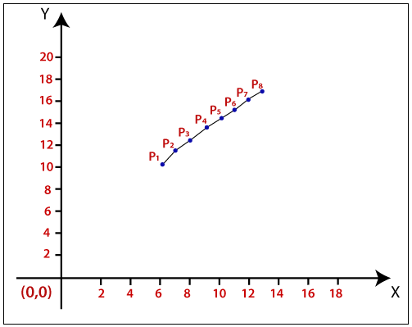

Slide 30
Advantages of Mid-point Subdivision Line Drawing Algorithm
It is very easy to implement.
It is a less time-consuming algorithm.
This algorithm uses basic arithmetic operations.
It only requires integer data.
The drawn line is smooth than other line drawing algorithms.
Disadvantages of Mid-point Subdivision Algorithm
Sometimes this algorithm is not suitable due to critical images and graphics.
The points have less accuracy. There are improvements needed.

Slide 31
ASSIGNMENT ONE
Using C++ and an IDE of your own choice, illustrate the configuration of C++ to work with OpenGL and the chosen IDE
Write suitable C++ and openGl code to create a window (800 x 800) cleared with a color of your own choice.
Write suitable code to draw
Line with default color and thickness
Dotted line with a color and thickness of your own choice.
NB: provide screen shot showing the code and the output in each case.
Due date 29/6/2021

